Slide 1

Chapter 12
DBSCAN (Density-Based Spatial Clustering of Applications with Noise)
Teh Ying Wah tehyw@um.edu.my University of Malaya

Slide 2

Course outline
Introduction to DBSCAN and its significance
DBSCAN algorithm with a simple example
Advantages and Limitations of DBSCAN
History of density-based clustering

Slide 3

Introduction to DBSCAN and its significance
DBSCAN stands for Density-Based Spatial Clustering of Applications with Noise. It's a popular clustering algorithm that differentiates itself from methods like K-means by being density-based.
Instead of relying on a predetermined number of clusters or hierarchical structures, DBSCAN groups together points that are packed closely to each other, based on a distance measure and a minimum number of points.

Slide 4
the strengths and weaknesses of DBSCAN compared to K-means and Agglomerative Clustering:
DBSCAN excels in identifying clusters of arbitrary shapes and detecting noise, making it ideal for spatial data and real-world applications where cluster numbers are unknown. However, its sensitivity to parameters and struggle with high-dimensional or varying density data can be limiting.
K-means is efficient and easy to use for simple, well-defined, spherical clusters, but requires pre-specifying the number of clusters and does not handle noise well. It performs poorly when clusters are irregular or overlapping.
Agglomerative Clustering provides a flexible approach that can create a hierarchical structure and handle different data types, making it suitable for exploratory data analysis. However, it is often computationally demanding and subjective due to linkage criteria and the choice of stopping level.

Slide 5
Core Concepts [1]
Density: In the context of DBSCAN, density is the number of points within a specified radius (ε).
Core Point: A point is a core point if there are at least a specified number of points (MinPts) within its ε-neighborhood, including the point itself.
Border Point: A point is a border point if it has fewer than MinPts within its ε-neighborhood but is in the neighborhood of a core point.
Noise Point: A point is considered noise if it's neither a core point nor a border point.

Slide 6

Significance of DBSCAN
Arbitrary Cluster Shapes: Unlike K-means, which tends to find spherical clusters, DBSCAN can identify clusters of arbitrary shapes. This is particularly useful for datasets where natural clusters aren't round.
No Need to Specify Number of Clusters: One of the challenges with K-means is deciding the value of 'K' (number of clusters). DBSCAN doesn't require this, making it more versatile in situations where the number of clusters is unknown.
Robustness to Noise: As the name suggests, DBSCAN explicitly identifies noise points. This makes the algorithm robust to outliers, distinguishing it from many other clustering methods.

Slide 7
Significance of DBSCAN
Density-based Clustering: DBSCAN's approach is intuitive in many real-world scenarios. For instance, in social network analysis, you might want to cluster based on the density of connections (friends or followers).
Simplicity and Versatility: DBSCAN is relatively simple to understand and implement. It's also versatile, being applicable to a wide range of domains, from astronomy (identifying star clusters) to biology (identifying colonies of organisms) to finance (identifying patterns in transaction data).
In conclusion, DBSCAN offers a unique approach to clustering that addresses some of the limitations of other methods. Its ability to find clusters of arbitrary shapes, its robustness to noise, and its density-based logic make it a valuable tool in the data scientist's arsenal.

Slide 8

Real-World Example: Clustering GPS Data for Smart City Applications Using DBSCAN
In modern smart cities, GPS data from vehicles, mobile devices, and IoT sensors are collected in real-time to monitor traffic conditions, manage public transport, and optimize urban planning. This data contains vast numbers of location points that can reveal valuable insights about traffic flow, hotspots, and unusual activity.
Scenario: Clustering the GPS locations of vehicles over time to identify traffic congestion areas and determine popular routes.
Advantages of DBSCAN:
Arbitrary Cluster Shapes: Traffic congestion zones do not fit neatly into circular or rectangular shapes—DBSCAN can identify complex, arbitrary patterns in GPS data, which is vital in real-world environments where roads curve, split, and join at different angles.
Noise Identification: GPS data often contains noise points such as random stops, outlier vehicle paths, or erroneous GPS readings. DBSCAN effectively marks these as noise, filtering out irrelevant data and focusing on true congestion areas or hotspots.
No Need for Number of Clusters: The number of clusters (i.e., areas of traffic congestion) is typically unknown and dynamic. DBSCAN’s ability to work without pre-specifying the number of clusters allows it to adapt to changing traffic conditions in real-time.

Slide 9

DBSCAN algorithm with a simple example
Example Dataset:
Suppose we have the following 2D data points:
A(1,2), B(2,2), C(2,3), D(8,8), E(8,9), F(25,25)
We'll use ‘ε = 2’ and ‘MinPts = 2’ for this example.
Step-by-step DBSCAN Walkthrough:
1. Initialization:
Start with the first point, A(1,2).
Mark A as visited.

Slide 10
DBSCAN algorithm with a simple example
2. Neighborhood Query for A:
Find points within distance ε = 2 of A.
Let's determine the distances from point A to the other points:
Distance between A and B:
Using the Euclidean distance formula:

Slide 11
DBSCAN algorithm with a simple example
Distance between A and C:
Using the Euclidean distance formula:
The distance is approximately 1.41, which is also less than ε (2).
For the other points (D, E, F), the distances to A are greater than ε, so they are not included in the ε-neighborhood of A.
Thus, based on the ε value of 2, both points B and C fall within the ε-neighborhood of A, along with A itself.

Slide 12

DBSCAN algorithm with a simple example
3. Expand Cluster or Mark Noise for A:
Since there are 3 points in the ε-neighborhood of A (including A itself) and MinPts = 2, A is a core point.
Start a new cluster, say Cluster 1, and assign A to it.
Now, explore the ε-neighborhood of A:
For point B: Mark B as visited and add it to Cluster 1.
For point C: Mark C as visited and add it to Cluster 1.
4. Move to the Next Point:
The next unvisited point is D(8,8).
Mark D as visited.

Slide 13
DBSCAN algorithm with a simple example
5. Neighborhood Query for D:
Find points within distance ε = 2 of D.
The ε-neighborhood of D includes D and E.
Let's determine the distance from point D to point E:
Distance between D and E:
The distance is 1, which is less than ε (2).
Given that the distance between D and E is 1, which is within the ε value of 2, point E falls within the ε-neighborhood of D. Therefore, the ε-neighborhood of D includes both D and E.

Slide 14
DBSCAN algorithm with a simple example
6. Expand Cluster or Mark Noise for D:
Since there are 2 points in the ε-neighborhood of D and MinPts = 2, D is a core point.
Start a new cluster, say Cluster 2, and assign D to it.
Now, explore the ε-neighborhood of D:
For point E: Mark E as visited and add it to Cluster 2.
7. Move to the Last Point:
The next unvisited point is F(25,25).
Mark F as visited.
8. Neighborhood Query for F:
Find points within distance ε = 2 of F.
The ε-neighborhood of F only includes F.

Slide 15
DBSCAN algorithm with a simple example
9. Expand Cluster or Mark Noise for F:
Since there's only 1 point in the ε-neighborhood of F and MinPts = 2, F is a noise point.
Result:
Cluster 1: A, B, C
Cluster 2: D, E
Noise: F
In this example, DBSCAN successfully identified two clusters and one noise point. The clusters are based on the density of points, and the algorithm was able to distinguish between dense regions and sparse regions (noise).

Slide 16

Advantages of DBSCAN
Arbitrary Cluster Shapes: Unlike centroid-based clustering methods like K-means, which tend to find spherical clusters, DBSCAN can identify clusters of arbitrary shapes.
No Need to Specify Number of Clusters: DBSCAN doesn't require the number of clusters to be specified in advance, unlike K-means.
Robustness to Noise: DBSCAN can distinguish between noise (outliers) and clusters. This makes the algorithm robust to outliers, as it can identify and ignore them.
Density-based Clustering: DBSCAN's logic is intuitive in many real-world scenarios. Clusters are dense regions in the data space separated by regions of lower point density.
Minimal Parameter Dependency: Only two parameters (ε and MinPts) need to be set, and there are heuristic methods available to estimate them.
No Assumption of Cluster Structure: DBSCAN doesn't assume clusters to be of any specific shape, as opposed to K-means which assumes clusters to be spherical.

Slide 17
Limitations of DBSCAN
Varying Densities: DBSCAN struggles with clusters of varying densities. If two clusters have significantly different densities, DBSCAN might not separate them correctly.
Border Points: Points that are reachable from more than one cluster can be part of either cluster, depending on the order the data is processed. This can lead to ambiguous assignments for border points.
Parameter Sensitivity: The results of DBSCAN can vary with different settings of ε and MinPts. Choosing appropriate values for these parameters is crucial, and there's no one-size-fits-all solution.
High-Dimensional Data: In high-dimensional spaces, the notion of "density" and "distance" becomes less clear-cut. DBSCAN can lose its effectiveness as dimensionality increases, a phenomenon known as the "curse of dimensionality."
Scalability: While DBSCAN is more efficient than many hierarchical clustering methods, it can still be computationally intensive for very large datasets.
Difficulty with Clusters of Similar Density: If clusters are nested and have similar densities, DBSCAN may recognize them as one single cluster.

Slide 18
Parameter Tuning Strategies
Techniques like k-distance graphs and heuristic rules provide good starting points for selecting ε and MinPts.
Automated methods such as Grid Search, Bayesian Optimization, and Genetic Algorithms help tune parameters efficiently, especially for large and complex datasets.
Modern methods like Reinforcement Learning offer flexibility for dynamically adjusting parameters in response to changing data environments, making DBSCAN even more practical in real-world and streaming data contexts.
These approaches help mitigate DBSCAN’s sensitivity to parameter selection, ensuring better clustering performance in diverse applications.

Slide 19

Scalability Improvements
Apache Spark is an effective solution for scaling DBSCAN using distributed computing. It is particularly useful for large, static datasets that can be processed across clusters.
CuML provides GPU acceleration, making DBSCAN suitable for real-time applications where speed is essential.
The combination of both tools enables handling extremely large datasets in both distributed and parallelized environments, enhancing the scalability and performance of DBSCAN significantly.
By leveraging tools like Apache Spark and CuML, DBSCAN’s clustering capabilities can be expanded beyond traditional limitations, making it suitable for analysing large-scale, real-time datasets efficiently in today's data-driven industries.

Slide 20
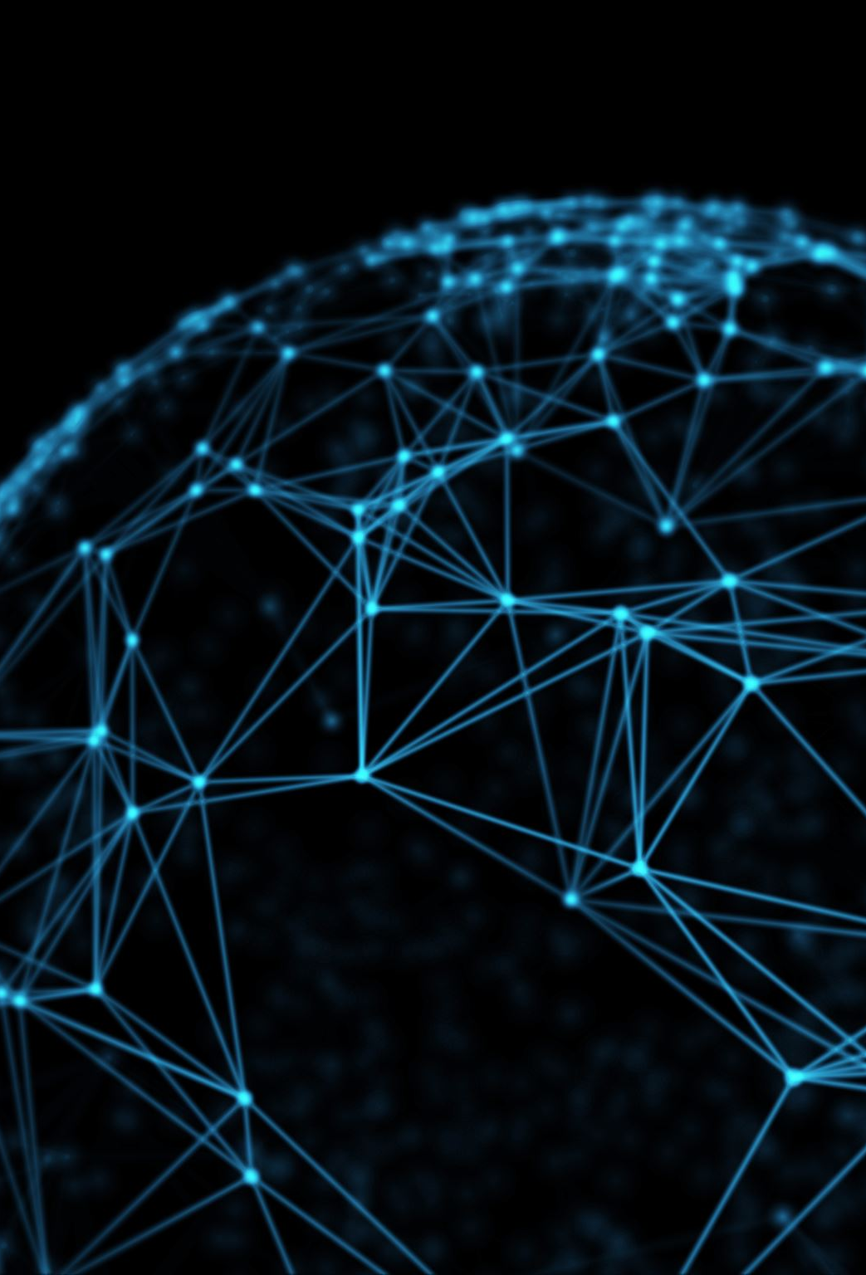
History of density-based clustering
Density-based clustering has its roots in the broader field of data clustering and pattern recognition. Over the years, various algorithms and techniques have been developed to address the challenges posed by different types of data and clustering requirements.
1. Early Beginnings:
The concept of clustering based on density can be traced back to early work in statistics and pattern recognition. The idea is to group data points based on regions of high density separated by regions of low density.
2. DBSCAN (1996):
The DBSCAN (Density-Based Spatial Clustering of Applications with Noise) algorithm, introduced by Martin Ester, Hans-Peter Kriegel, Jörg Sander, and Xiaowei Xu in 1996, is arguably the most well-known density-based clustering algorithm.
DBSCAN was revolutionary because it could find clusters of arbitrary shapes (unlike K-means, which tends to find spherical clusters) and could identify noise or outliers.

Slide 21

History of density-based clustering
3. OPTICS (1999):
OPTICS (Ordering Points To Identify the Clustering Structure), introduced by Mihael Ankerst, Markus M. Breunig, Hans-Peter Kriegel, and Jörg Sander in 1999, is an extension of DBSCAN.
OPTICS introduced the concept of a reachability plot, which provides a more detailed clustering structure and can handle varying densities better than DBSCAN.
4. DENCLUE (1998):
DENCLUE (DENsity-based CLUstEring), introduced by Alexander Hinneburg and Daniel A. Keim in 1998, uses a density distribution function and a hill-climbing algorithm. It's particularly suitable for high-dimensional data.

Slide 22
History of density-based clustering
5. Further Developments:
Over the years, several variations and extensions of density-based clustering algorithms were developed to address specific challenges:
HDBSCAN: An extension of DBSCAN that works hierarchically to find clusters of varying densities.
MR-DBSCAN: A multi-resolution version of DBSCAN.
GDBSCAN: A grid-based version of DBSCAN.
ROCK: Designed for categorical data using links instead of distances.

Slide 23

History of density-based clustering
6. Modern Applications and Challenges:
With the advent of big data and evolving data streams, new challenges emerged, leading to the development of algorithms like MuDi-Stream [2] for streaming data with varying densities.
Density-based clustering has found applications in various domains, including bioinformatics, geospatial analysis, image processing, and anomaly detection.
7. Current Research:
Current research in density-based clustering focuses on scalability for large datasets, adaptability for dynamic data sources, handling high-dimensional data, and integrating domain knowledge into the clustering process.
In conclusion, density-based clustering has evolved significantly since its inception, with numerous algorithms developed to address the diverse challenges posed by different types of data. The field continues to be an active area of research, with new methods and applications emerging regularly.

Slide 24

Hybrid Approaches with DBSCAN
DBSCAN is a powerful clustering method, especially for detecting clusters of arbitrary shapes and handling noise effectively. However, it also has some limitations, such as difficulty in handling clusters with varying densities and parameter sensitivity. To leverage DBSCAN’s strengths while mitigating its weaknesses, it can be used in combination with other clustering methods.
K-means and DBSCAN can be combined to utilize the efficiency of K-means for initial grouping and the flexibility of DBSCAN for refining clusters and noise detection.
Hierarchical Clustering with DBSCAN allows for refining broad clusters and detecting irregular shapes and noise effectively.
Ensemble Approaches leverage multiple clustering methods to create more robust and comprehensive clustering solutions.
DBSCAN as Preprocessing helps in removing noise to make other clustering methods more effective and computationally feasible.
Dimensionality Reduction + DBSCAN helps make DBSCAN suitable for high-dimensional datasets by simplifying the feature space.

Slide 25
Summary and Future Directions
current research directions, such as adapting DBSCAN for evolving data streams and high-dimensional data.
density-based clustering methods are evolving in response to the demands of new computing paradigms, such as Edge AI and Federated Learning. These fields involve distributed data processing and require advanced clustering techniques that can operate efficiently with limited computational resources, decentralized data, and privacy constraints.
Smart Transportation: Onboard edge devices (e.g., in autonomous cars) can use DBSCAN to identify traffic patterns and navigate efficiently by clustering local traffic density in real time.
Healthcare Monitoring: Wearable health devices can use lightweight DBSCAN variants to cluster real-time health data (e.g., heart rate) and detect abnormal patterns, enabling proactive intervention.
Healthcare: Hospitals can use federated DBSCAN to cluster patient data (e.g., health metrics like blood pressure, heart rate) to detect trends or anomalies across hospitals without sharing sensitive patient information.

Slide 26
Reference
[1] https://link.springer.com/article/10.1007/s11390-014-1416-y
[2] https://www.sciencedirect.com/science/article/pii/S1084804514002665

